Slide 1




CS7.405 Responsible & Safe AI Systems
Ponnurangam Kumaraguru (“PK”)
#ProfGiri @ IIIT Hyderabad
pk.profgiri
/in/ponguru
@ponguru
Ponnurangam.kumaraguru

Slide 2




Protocol

Slide 3
Who you are?
CND
ECD
EHD
ECE
CLD
CSE
CSD
???

Slide 4
Who am I?
Assistant Associate Professor of Computer Science
Ph.D. from School of Computer Science, Carnegie Mellon University (CMU)
Research interests
Computational Social Science
Social (Societal) Computing
Privacy & Security in Social Media
Courses I teach
Data & Applications (1), 4+
Online Privacy (1)
Privacy and Security in Online Social Media (8), 4+
Designing Human Centered Systems (5), 4+
Research methods / Advanced research methods (2), 4+
Foundations of Computer Security (5), 4+
Big Data & Policing (1), 4+
30

Slide 5
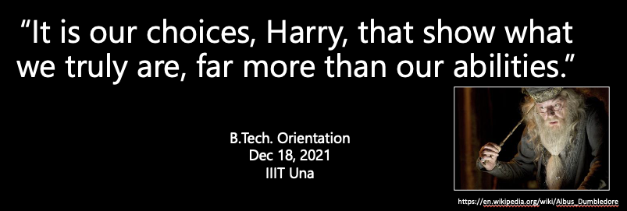
My Philosophy
“It is our choices [project, group members, course, professor to work with ☺ etc.], Harry, that show what we truly are, far more than our abilities.”

Slide 6
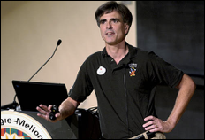
My Philosophy
Work hard smart, play hard
Brick walls are there for a reason. The brick walls are not there to keep us out. The brick walls are there to show how badly we want something.
If the requests are reasonable, most of the course related decisions (deadline extension, …) , will be student-friendly, so, concentrate on the content

Slide 7
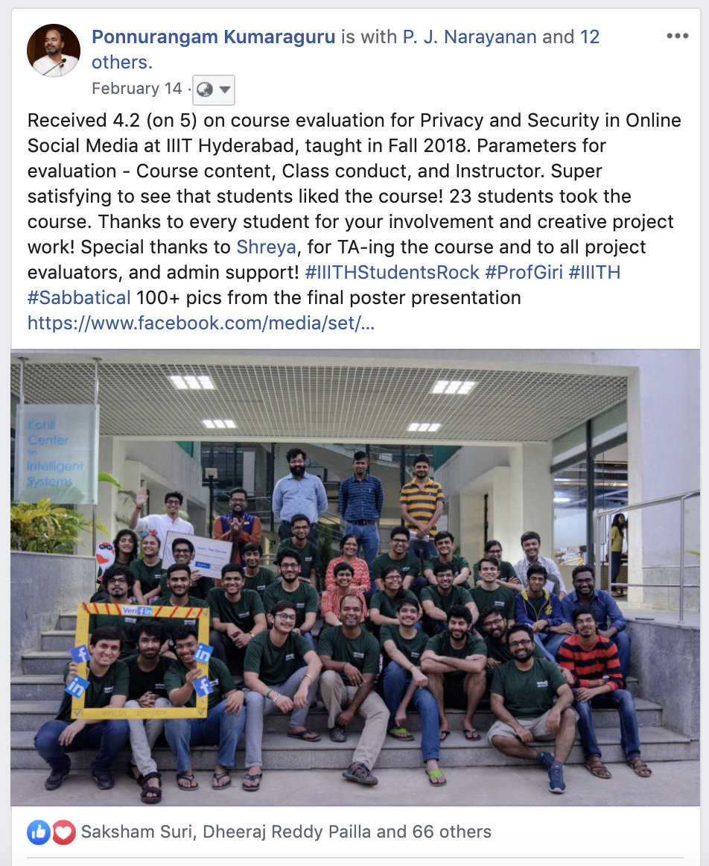
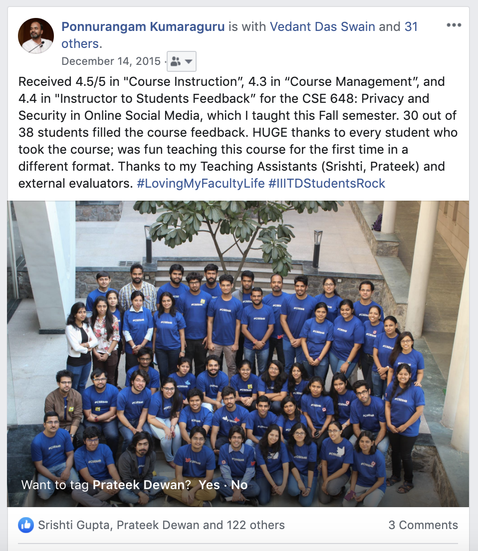

Slide 8
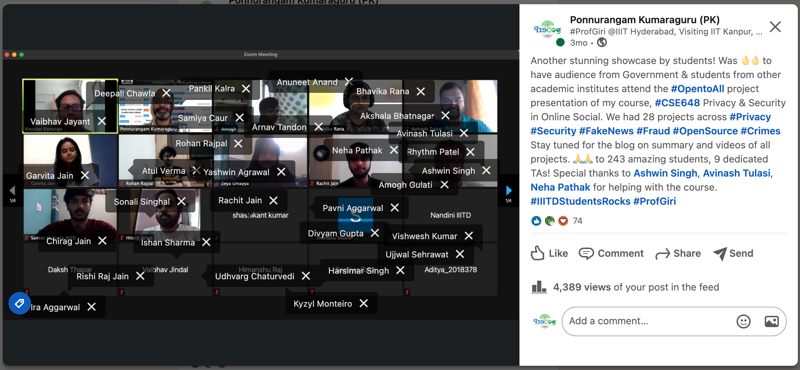
Fun at the end of the semester!

Slide 9
Why should I teach this course?
Super thrilled and excited about the topic
Realization on the importance of systems being responsible & safe
Multiple Ph.D. students, Masters / DD, UG, RAs work with me in this area
There are plans for summer school around this topic on campus

Slide 10
Post Conditions
C0-1: Students will recognize possible harms that can be caused by modern AI capabilities
C0-2: Students will learn to reason about various perspectives on the trajectory of AI development and proliferation
C0-3: Students will learn about latest research agendas towards making AI systems safer
C0-4: Students will be able to design and run experiments for understanding capabilities of current AI systems.
C0-5: Students will conduct, develop, and practice the techniques needed to make AI systems safer through course project

Slide 11
Pedagogy
Learning
Lectures
Reading research papers
Class participation: questions, discussions
Tutorials
Online discussion: Moodle
Learning by doing
Course project
Real world issues
Interdisciplinary approach

Slide 12
Grading, Relative
Type of Evaluation | Weightage (in %)
Quiz-II | 10
Assignments (2) | 25
Project report + Blog + Video | 10 [6 + 2 + 2]
Project | 30
Mid-term | 20
Activity / Tutorial-Follow-ups | 5

Slide 13
Project evaluation
One review every 4 weeks
Total of 4 reviews
5 + 5 + 5 + 15 marks
External evaluators for the projects (preferably mid & final)
If things work out well, you can continue working on the project through the summer / fall semester

Slide 14
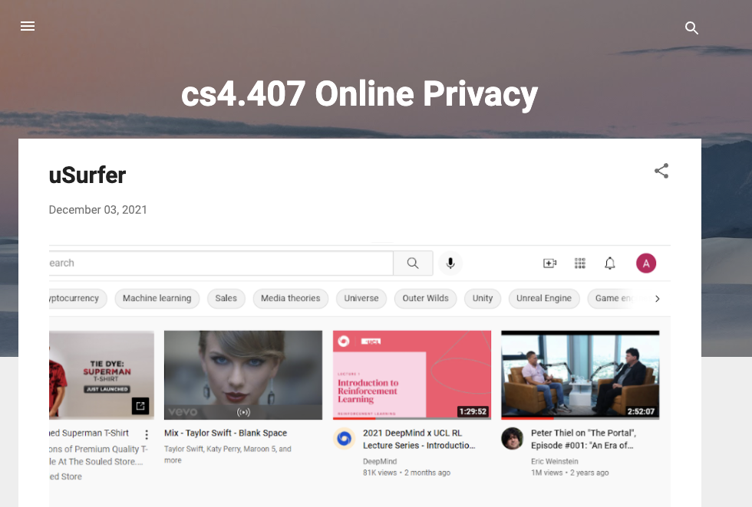
TAs
https://cs4-407-online-privacy.blogspot.com/

Slide 15
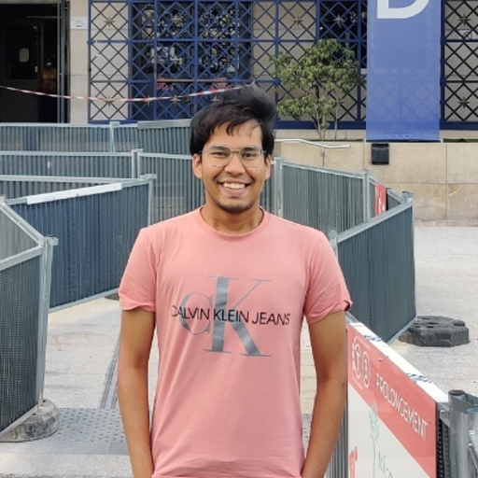
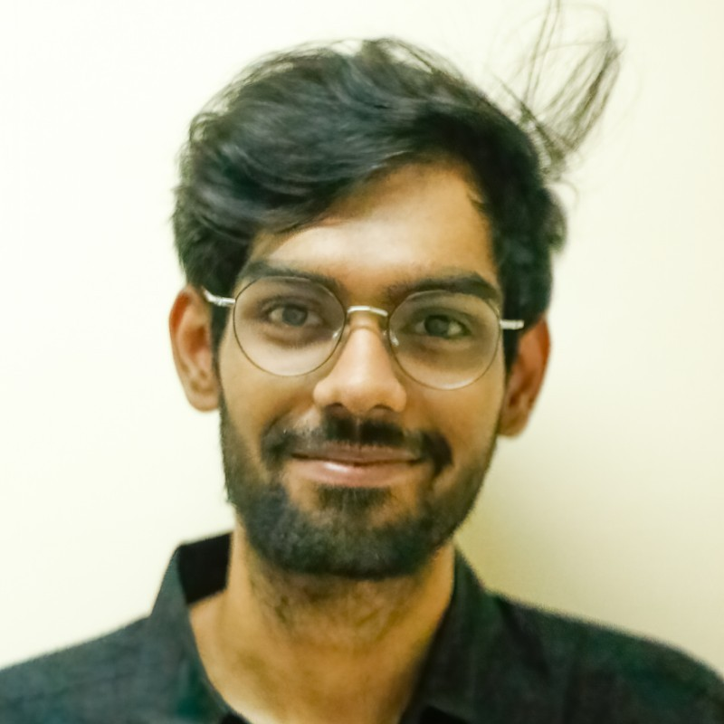
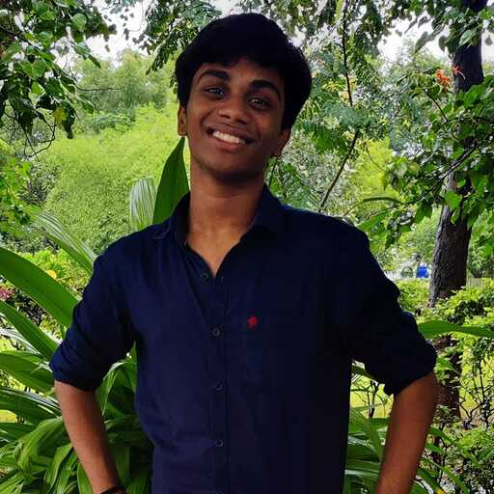
TAs

Slide 16
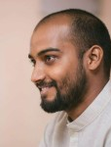
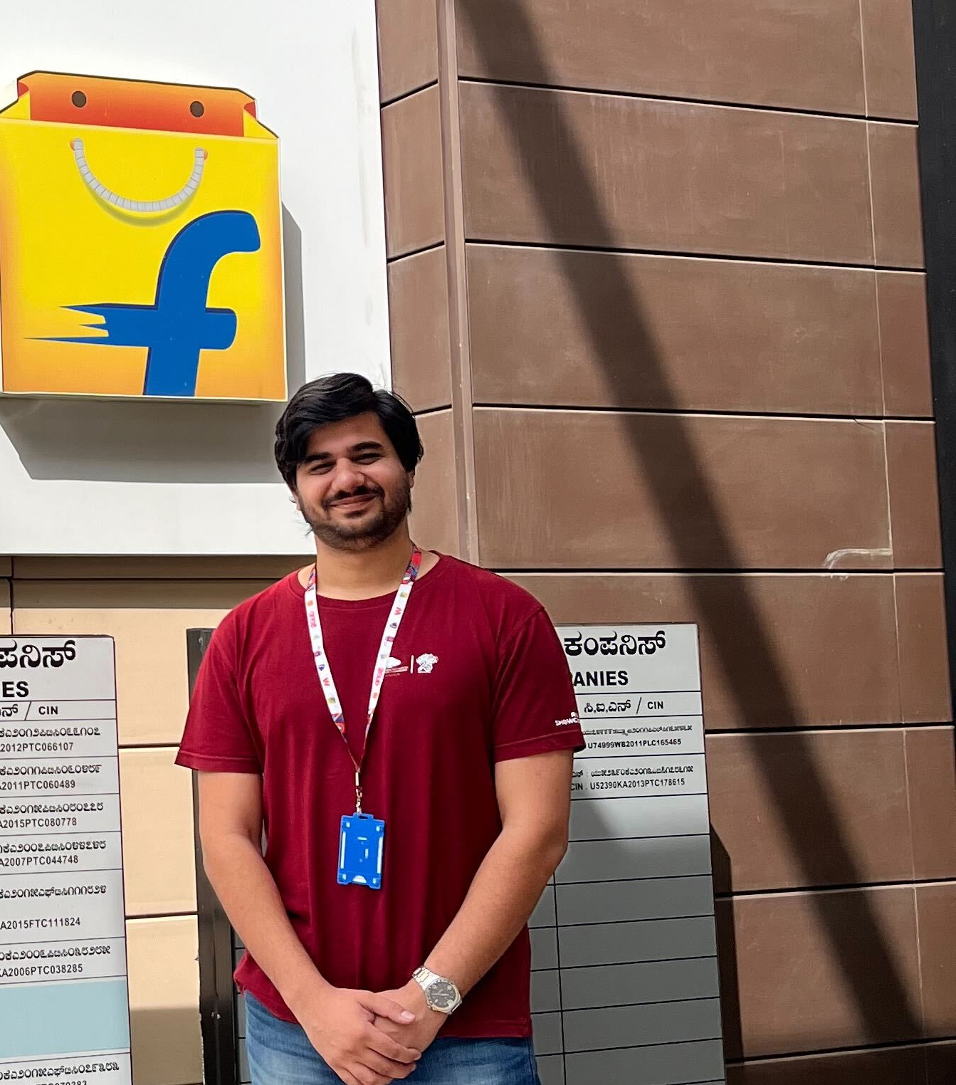
Project Mentors (optional)

Slide 17
Disclaimer
Given the nature of the topic, it is exciting and relevant, so we can look at what is happening during the semester and pick them up
Will be happy to change (a bit) the content as we proceed
Discuss about GAB in Fall 2018 semester
Will be great to have these going on Moodle?
I am excited, willing to learn, and modify as it works for you
If you focus on looking at some interesting problems around, you and if we can address it through the class that will be super cool!

Slide 18
Other details
Course timings & Classroom
Mondays 0830 – 1000 hrs
Thursdays 0830 – 1000 hrs
Course materials
No prescribed book
Papers will be circulated
All course materials will be shared on Moodle
Office hours
We will announce it soon
PK & TAs
Will try and share slides before the class

Slide 19
Guest Lectures
Wendy Hall, Univ of Southampton
Neel Nanda, Google DeepMind
Arun Jose, Independent Researcher
Prof. Ravi Balaraman, IIT Madras
Daniel Paleka, PhD Student, ETH Zurich
Dr. Adam Gleave, CEO FAR AI
Dr. Dan Hendrycks, Director of Center for AI
Dr. Ethan Perez, Research Scientist, Anthropic
Prof. Vincent Conitzer, Carnegie Mellon University
Anybody more?
Mostly evening IST!

Slide 20
Plagiarism
What is it?
Copying HWs
Any content taken from another source without citation
First time caught, zero on that submission
Second time caught will be directed to academic committee
Caught in final report, one grade lower
Whatever policy from IIITH

Slide 21
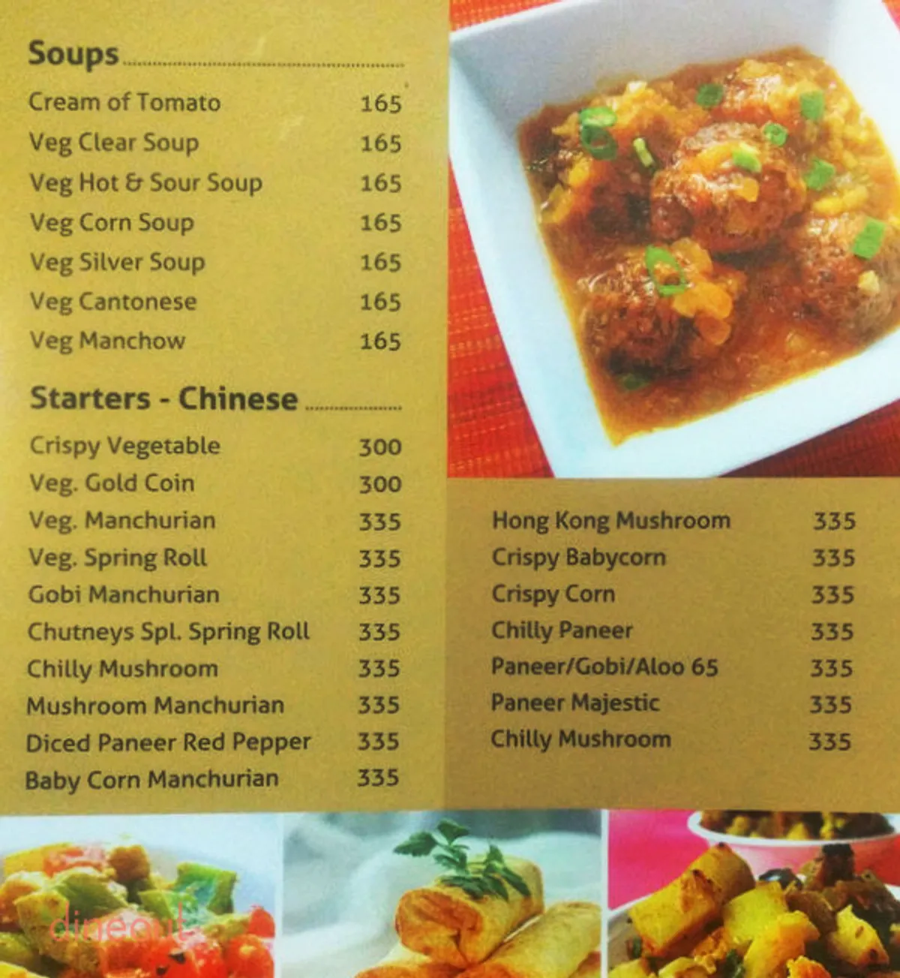
Topics that we will cover
Introduction to AI Capabilities and Risks
Robustness
Transparency
Artificial General Intelligence
AI Governance and Career Opportunities
https://www.dineout.co.in/hyderabad/chutneys-madhapur-west-hyderabad-11747/menu

Slide 22
Moodle
We will use Moodle for all content sharing – slides, HWs, announcements, clarifications, etc.

Slide 23
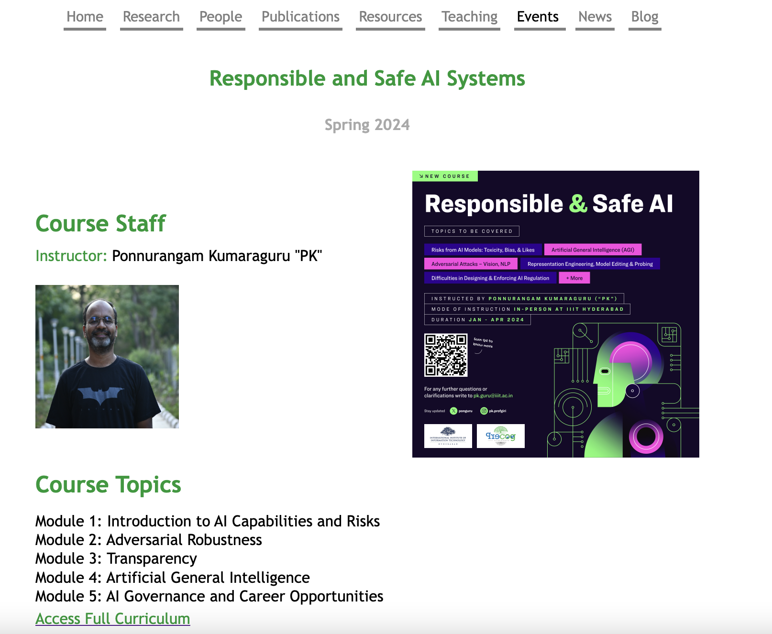
Course website
https://precog.iiit.ac.in/teaching/responsible-ai/

Slide 24
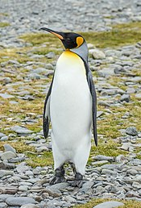
Award
Brave penguin to take the 1st dive
Hard problem
Consistent efforts during the semester

Slide 25
Service Level Agreement
Any question / clarification ask, if not urgent, will be answered in 24 hrs
If anything, urgent, feel free to attach the time in which you want the answer, we will try to respond
TAs are your 1st point of contact only on escalation, you will bring it up to me

Slide 26
Who you are?
You name
Your program
Why taking this course in a couple of lines
Lets discuss a few of these after you are done
What do you want to get out of the class?
Write in the paper, with your name and Roll #

Slide 27
Any questions / clarifications?

Slide 28
Improvement in AI capabilities: Your list? Your life time?

Slide 29
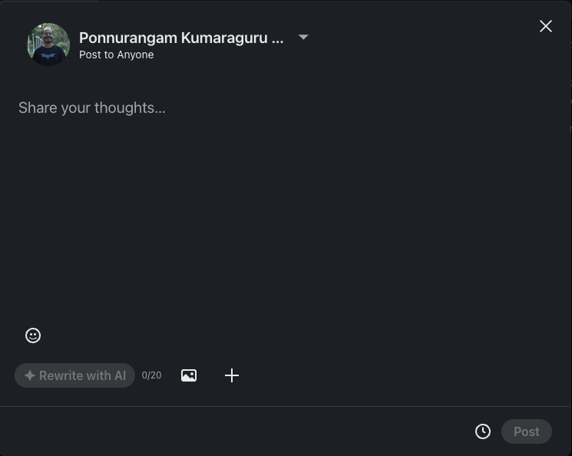
Improvement in AI capabilities

Slide 30
Improvement in AI capabilities: Your list?
Transportation
Healthcare
Banking
Entertainment
E-Commerce
Education

Slide 31
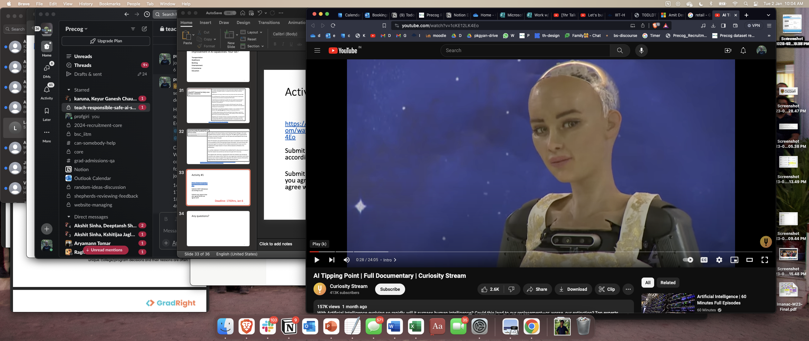
Activity #1
AI Tipping point
https://www.youtube.com/watch?v=1cKE12LK4Eo Submit 3 KEY takeaways according to you
Submit any aspect that you agree & did not agree with
Deadline: 23:59hrs, Jan 6

Slide 32
Any questions?

Slide 33
Bibliography / Acknowledgements

Slide 34





pk.profgiri
Ponnurangam.kumaraguru
/in/ponguru
ponguru
Thank you
for attending the class!!!
pk.guru@iiit.ac.in

